Slide 1


Rafael Paz Silva
05/01/2022

Slide 2

Outline
Executive Summary
Introduction
Methodology
Results
Conclusion
Appendix
2
Notes:
<number>

Slide 3
Executive Summary
Summary of methodologies
Collecting the data
Web scraping
Data wrangling
EDA for data visualization
EDA with SQL
Map Analysis with Folium
Dashboard with Plotly Dash
Machine Learning Prediction
Summary of all results
Exploratory data analysis results
Interactive analytics demo in screenshots
Predictive analysis results
3

Slide 4
Introduction
Project background and context
We predicted if the Falcon 9 first stage will land successfully. SpaceX advertises Falcon 9 rocket launches on its website, with a cost of 62 million dollars; other providers cost upward of 165 million dollars each, much of the savings is because SpaceX can reuse the first stage. Therefore, if we can determine if the first stage will land, we can determine the cost of a launch. This information can be used if an alternate company wants to bid against SpaceX for a rocket launch.
Problems you want to find answers
What influences if the rocket will land successfully?
The effect each relationship with certain rocket variables will impact in determining the success rate of a successful landing.
What conditions does SpaceX have to achieve to get the best results and ensure the best rocket success landing rate.
4

Slide 5

4

Slide 6
Methodology
Data collection methodology:
SpaceX Rest API
(Web Scrapping) from Wikipedia
Performed data wrangling (Transforming data for Machine Learning)
One Hot Encoding data fields for Machine Learning and dropping irrelevant columns
Performed exploratory data analysis (EDA) using visualization and SQL
Plotting : Scatter Graphs, Bar Graphs to show relationships between variables to show patterns of data.
• Performed interactive visual analytics using Folium and Plotly Dash
• Performed predictive analysis using classification models
How to build, tune, evaluate classification models
4
Notes:
<number>

Slide 7
Data Collection
• We worked with SpaceX launch data that is gathered from the SpaceX REST API.
• This API will give us data about launches, including information about the rocket used,
payload delivered, launch specifications, landing specifications, and landing outcome.
• Our goal is to use this data to predict whether SpaceX will attempt to land a rocket or not.
• The SpaceX REST API endpoints, or URL, starts with api.spacexdata.com/v4/.
• Another popular data source for obtaining Falcon 9 Launch data is web scraping Wikipedia using
BeautifulSoup.
6

Slide 8
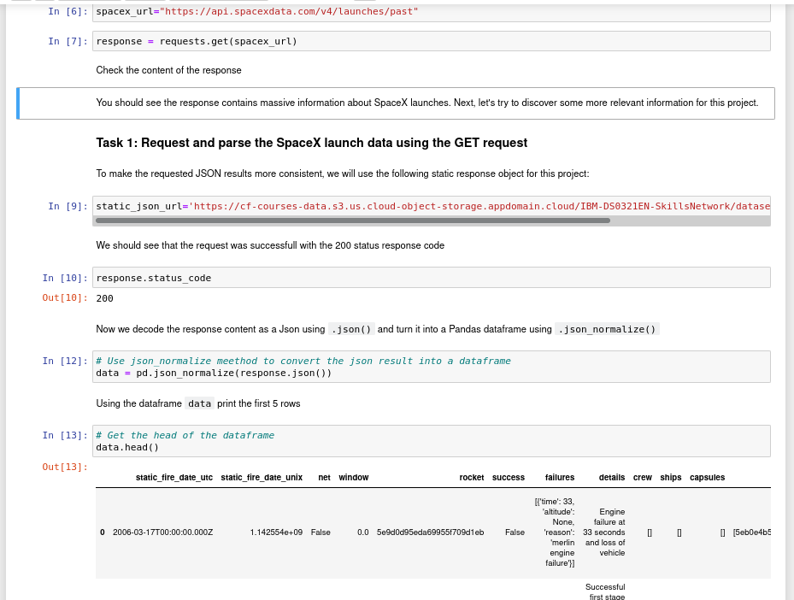
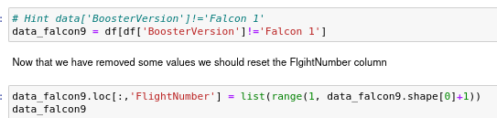
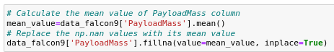
Data Collection – SpaceX API
Request and parse the SpaceX launch data using the GET request
Filter the dataframe to only include Falcon 9 launches
Dealing with Missing Values
7
Github URL: ????????????????????????????????????????????????

Slide 9
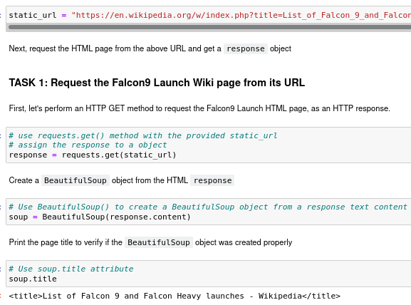
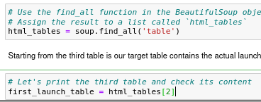
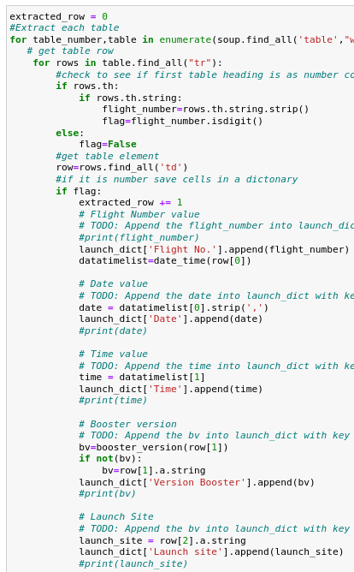
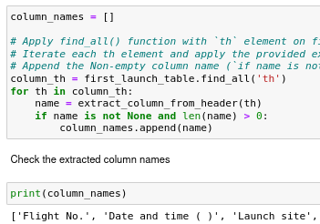
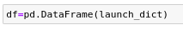
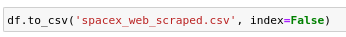
Data Collection - Scraping
Request the Falcon9 Launch Wiki page from its URL
Extract all column/variable names from the HTML table header
Create a data frame by parsing the launch HTML tables
Save csv:
8
Github URL: ????????????????????????????????????????????????

Slide 10
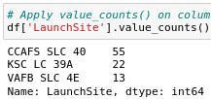
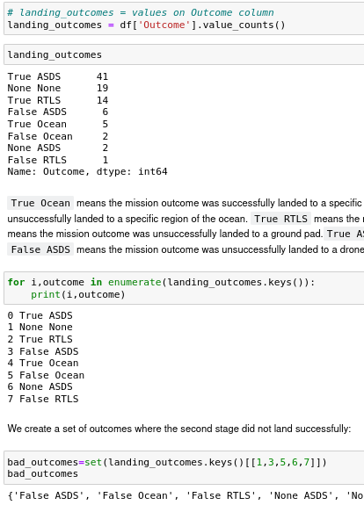
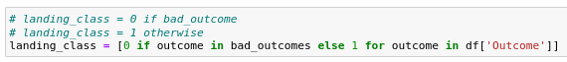
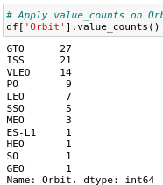
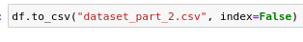
Data Wrangling
Calculate the number of launches on each site
Calculate the number and occurence of mission outcome per orbit type
Create a landing outcome label from Outcome column
Calculate the number and occurrence of each orbit
Save file:
9
Github URL: ????????????????????????????????????????????????

Slide 11
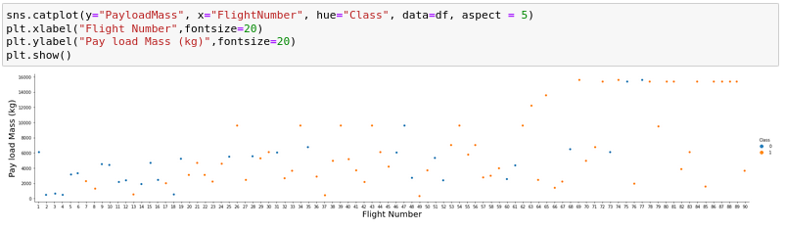
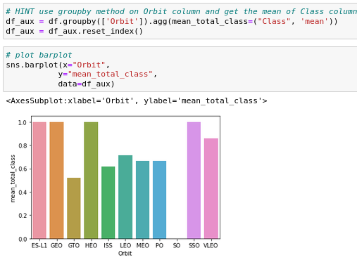
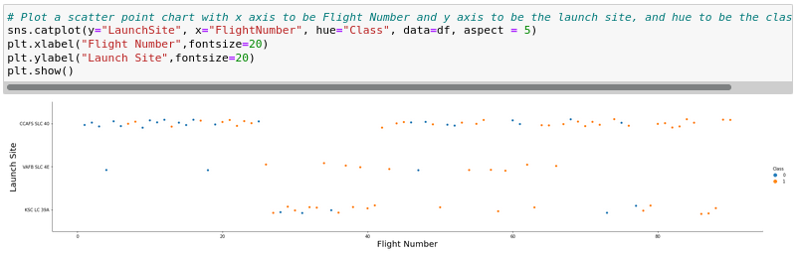
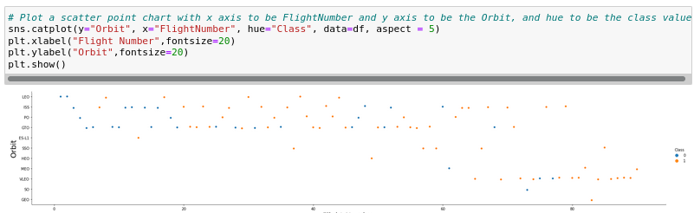
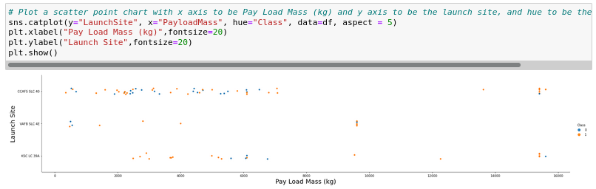
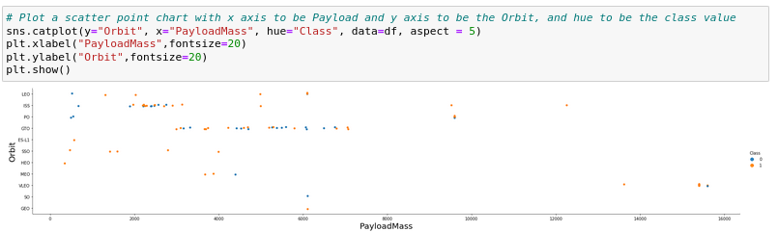
EDA with Data Visualization
Flight Number x Pay Load Mass
Relationship between success rate of each orbit type
Flight Number x Launch Site
FlightNumber x Orbit type
Launch Site x Pay Load Mass
Payload x Orbit type
10

Slide 12
EDA with SQL
Using bullet point format, summarize the SQL queries you performed
Add the GitHub URL of your completed EDA with SQL notebook, as an external reference and peer-review purpose
11

Slide 13
Build an Interactive Map with Folium
Summarize what map objects such as markers, circles, lines, etc. you created and added to a folium map
Explain why you added those objects
Add the GitHub URL of your completed interactive map with Folium map, as an external reference and peer-review purpose
12

Slide 14
Build a Dashboard with Plotly Dash
Summarize what plots/graphs and interactions you have added to a dashboard
Explain why you added those plots and interactions
Add the GitHub URL of your completed Plotly Dash lab, as an external reference and peer-review purpose
13

Slide 15
Predictive Analysis (Classification)
Summarize how you built, evaluated, improved, and found the best performing classification model
You need present your model development process using key phrases and flowchart
Add the GitHub URL of your completed predictive analysis lab, as an external reference and peer-review purpose
14

Slide 16
Results
Exploratory data analysis results
Interactive analytics demo in screenshots
Predictive analysis results
16
Notes:
<number>

Slide 17


Slide 18
Flight Number vs. Launch Site
Show a scatter plot of Flight Number vs. Launch Site
Show the screenshot of the scatter plot with explanations
16

Slide 19
Payload vs. Launch Site
Show a scatter plot of Payload vs. Launch Site
Show the screenshot of the scatter plot with explanations
18

Slide 20
Success Rate vs. Orbit Type
Show a bar chart for the success rate of each orbit type
Show the screenshot of the scatter plot with explanations
19

Slide 21
Flight Number vs. Orbit Type
Show a scatter point of Flight number vs. Orbit type
Show the screenshot of the scatter plot with explanations
20

Slide 22
Payload vs. Orbit Type
Show a scatter point of payload vs. orbit type
Show the screenshot of the scatter plot with explanations
21

Slide 23
Launch Success Yearly Trend
Show a line chart of yearly average success rate
Show the screenshot of the scatter plot with explanations
22

Slide 24
All Launch Site Names
Find the names of the unique launch sites
Present your query result with a short explanation here
23

Slide 25
Launch Site Names Begin with 'CCA'
Find 5 records where launch sites begin with `CCA`
Present your query result with a short explanation here
24

Slide 26
Total Payload Mass
Calculate the total payload carried by boosters from NASA
Present your query result with a short explanation here
25

Slide 27
Average Payload Mass by F9 v1.1
Calculate the average payload mass carried by booster version F9 v1.1
Present your query result with a short explanation here
26

Slide 28
First Successful Ground Landing Date
Find the dates of the first successful landing outcome on ground pad
Present your query result with a short explanation here
27

Slide 29
Successful Drone Ship Landing with Payload between 4000 and 6000
List the names of boosters which have successfully landed on drone ship and had payload mass greater than 4000 but less than 6000
Present your query result with a short explanation here
28

Slide 30
Total Number of Successful and Failure Mission Outcomes
Calculate the total number of successful and failure mission outcomes
Present your query result with a short explanation here
29

Slide 31
Boosters Carried Maximum Payload
List the names of the booster which have carried the maximum payload mass
Present your query result with a short explanation here
30

Slide 32
2015 Launch Records
List the failed landing_outcomes in drone ship, their booster versions, and launch site names for in year 2015
Present your query result with a short explanation here
31

Slide 33
Rank Landing Outcomes Between 2010-06-04 and 2017-03-20
Rank the count of landing outcomes (such as Failure (drone ship) or Success (ground pad)) between the date 2010-06-04 and 2017-03-20, in descending order
Present your query result with a short explanation here
32

Slide 34


Slide 35
<Folium Map Screenshot 1>
Replace <Folium map screenshot 1> title with an appropriate title
Explore the generated folium map and make a proper screenshot to include all launch sites’ location markers on a global map
Explain the important elements and findings on the screenshot
<number>

Slide 36
<Folium Map Screenshot 2>
Replace <Folium map screenshot 2> title with an appropriate title
Explore the folium map and make a proper screenshot to show the color-labeled launch outcomes on the map
Explain the important elements and findings on the screenshot
<number>

Slide 37
<Folium Map Screenshot 3>
Replace <Folium map screenshot 3> title with an appropriate title
Explore the generated folium map and show the screenshot of a selected launch site to its proximities such as railway, highway, coastline, with distance calculated and displayed
Explain the important elements and findings on the screenshot
<number>

Slide 38


Slide 39
<Dashboard Screenshot 1>
Replace <Dashboard screenshot 1> title with an appropriate title
Show the screenshot of launch success count for all sites, in a piechart
Explain the important elements and findings on the screenshot
<number>

Slide 40
<Dashboard Screenshot 2>
Replace <Dashboard screenshot 2> title with an appropriate title
Show the screenshot of the piechart for the launch site with highest launch success ratio
Explain the important elements and findings on the screenshot
<number>

Slide 41
<Dashboard Screenshot 3>
Replace <Dashboard screenshot 3> title with an appropriate title
Show screenshots of Payload vs. Launch Outcome scatter plot for all sites, with different payload selected in the range slider
Explain the important elements and findings on the screenshot, such as which payload range or booster version have the largest success rate, etc.
<number>

Slide 42


Slide 43
Classification Accuracy
Visualize the built model accuracy for all built classification models, in a bar chart
Find which model has the highest classification accuracy
<number>

Slide 44
Confusion Matrix
Show the confusion matrix of the best performing model with an explanation
<number>

Slide 45
Conclusions
Point 1
Point 2
Point 3
Point 4
…
<number>

Slide 46
Appendix
Include any relevant assets like Python code snippets, SQL queries, charts, Notebook outputs, or data sets that you may have created during this project
<number>
Notes:
<number>

Slide 47


